Slide 1
Chapter 10
Error Detection and Correction

Slide 2

Note
Data can be corrupted
during transmission (three impairments: attenuation, distortion, noise).
Some applications require that
errors be detected and corrected.

Slide 3
10-1 INTRODUCTION
Let us first discuss some issues related, directly or indirectly, to error detection and correction.
Topics discussed in this section:
Types of Errors
Redundancy
Detection Versus Correction
Coding
Forward Error Correction Versus Retransmission

Slide 4
Note
In a single-bit error, only 1 bit in the data unit has changed.

Slide 5
10.10.1 Types of Errors
Whenever bits flow from one point to another, they are subject to unpredictable changes because of interference. This interference can change the shape of the signal. The term single-bit error means that only 1 bit of a given data unit (such as a byte, character, or packet) is changed from 1 to 0 or from 0 to 1. The term burst error means that 2 or more bits in the data unit have changed from 1 to 0 or from 0 to 1. Figure 10.1 shows the effect of a single-bit and a burst error on a data unit.

Slide 6
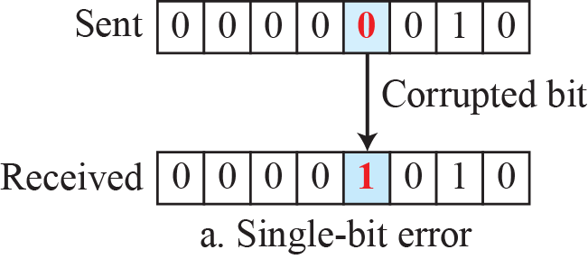
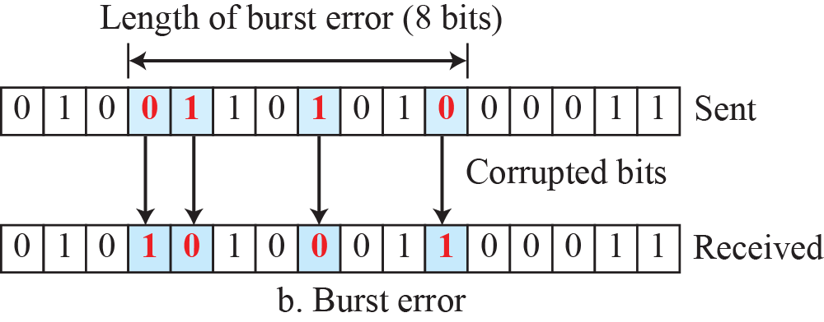
Figure 10.1: Single-bit and burst error

Slide 7
10.10.2 Redundancy
The central concept in detecting or correcting errors is redundancy. To be able to detect or correct errors, we need to send some extra bits with our data. These redundant bits are added by the sender and removed by the receiver. Their presence allows the receiver to detect or correct corrupted bits.

Slide 8
10.10.3 Detection versus Correction
The correction of errors is more difficult than the detection. In error detection, we are only looking to see if any error has occurred. The answer is a simple yes or no. We are not even interested in the number of corrupted bits. A single-bit error is the same for us as a burst error. In error correction, we need to know the exact number of bits that are corrupted and, more importantly, their location in the message.

Slide 9
10.10.4 Coding
Redundancy is achieved through various coding schemes. The sender adds redundant bits through a process that creates a relationship between the redundant bits and the actual data bits. The receiver checks the relationships between the two sets of bits to detect errors. The ratio of redundant bits to data bits and the robustness of the process are important factors in any coding scheme.

Slide 10
    10-2 BLOCK CODING
In block coding, we divide our message into blocks, each of k bits, called datawords. We add r redundant bits to each block to make the length n = k + r. The resulting n-bit blocks are called codewords. How the extra r bits are chosen or calculated is something
we will discuss later.

Slide 11
10.2.1 Error Detection
How can errors be detected by using block coding? If the following two conditions are met, the receiver can detect a change in the original codeword.
1. The receiver has (or can find) a list of valid
codewords.
2. The original codeword has changed to an invalid
one.

Slide 12
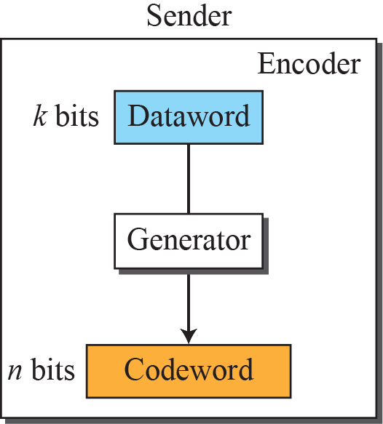
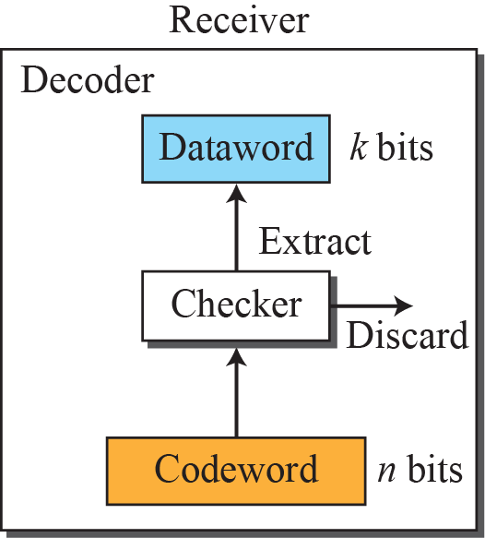

Figure 10.2: Process of error detection in block coding
10.12

Slide 13
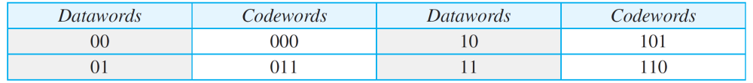
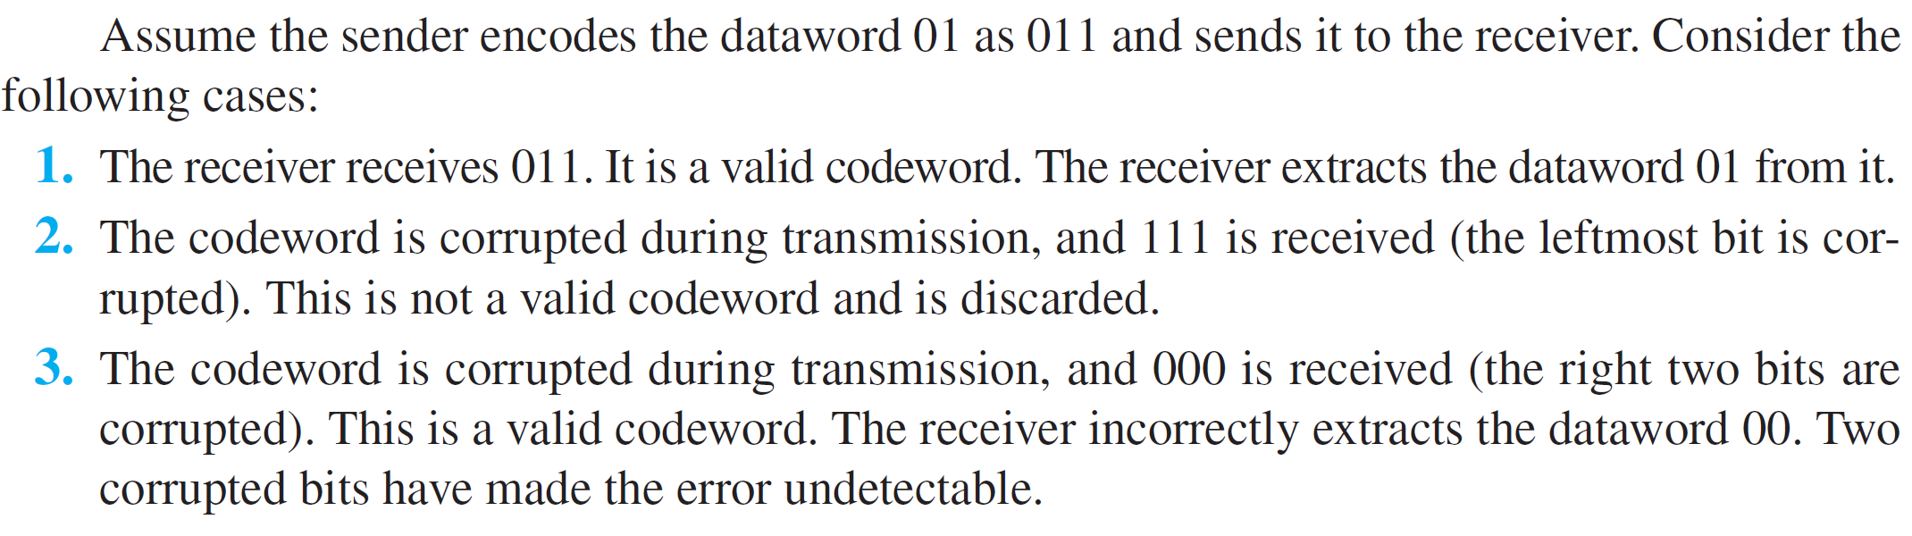
Example 10.1
Let us assume that k = 2 and n = 3. Table 10.1 shows the list of datawords and codewords. Later, we will see how to derive a codeword from a dataword.
Table 10.1: A code for error detection in Example 10.1
10.13

Slide 14
Example 10.2
Let us find the Hamming distance between two pairs of words.
10.14

Slide 15
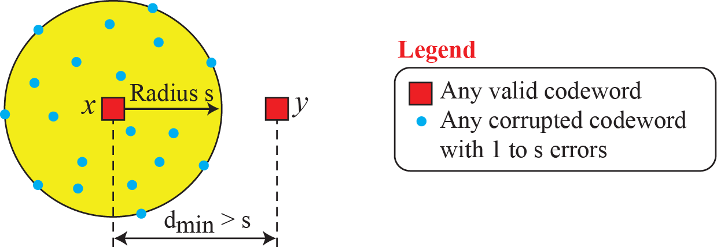
Figure 10.3: Geometric concept explaining dmin in error detection

Slide 16
Example 10.3
The minimum Hamming distance for our first code scheme (Table 10.1) is 2. This code guarantees detection of only a single error. For example, if the third codeword (101) is sent and one error occurs, the received codeword does not match any valid codeword. If two errors occur, however, the received codeword may match a valid codeword and the errors are not detected.
10.16

Slide 17
Example 10.4
A code scheme has a Hamming distance dmin = 4. This code guarantees the detection of up to three errors (d = s + 1 or
s = 3).
10.17

Slide 18
Example 10.5
The code in Table 10.1 is a linear block code because the result of XORing any codeword with any other codeword is a valid codeword. For example, the XORing of the second and third codewords creates the fourth one.
10.18

Slide 19
Example 10.6
In our first code (Table 10.1), the numbers of 1s in the nonzero codewords are 2, 2, and 2. So the minimum Hamming distance is dmin = 2.
10.19

Slide 20
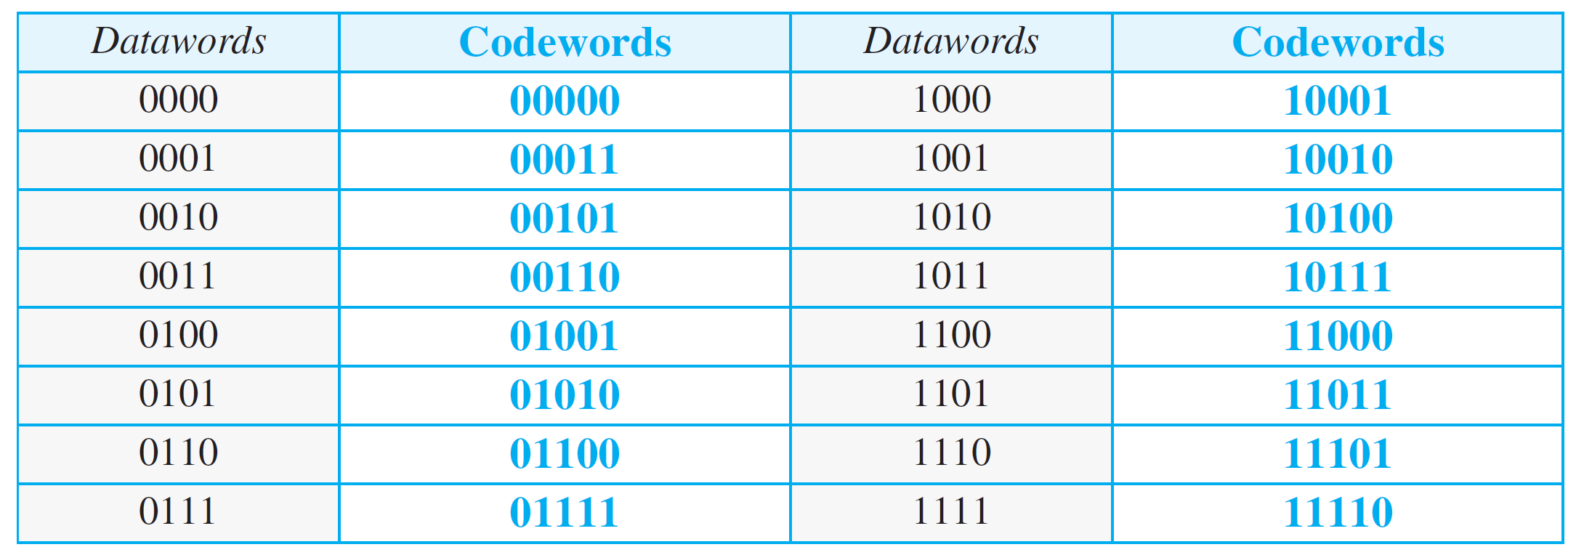
Table 10.2: Simple parity-check code C(5, 4)
10.20

Slide 21
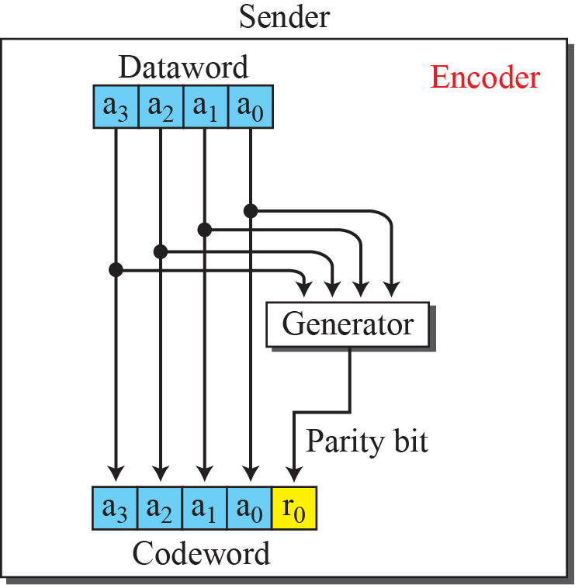
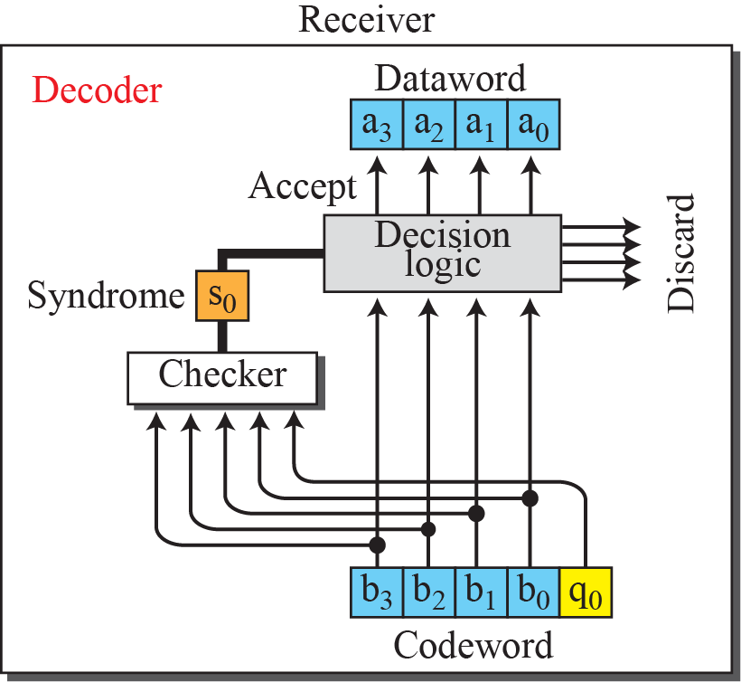
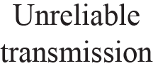
Figure 10.4: Encoder and decoder for simple parity-check code

Slide 22
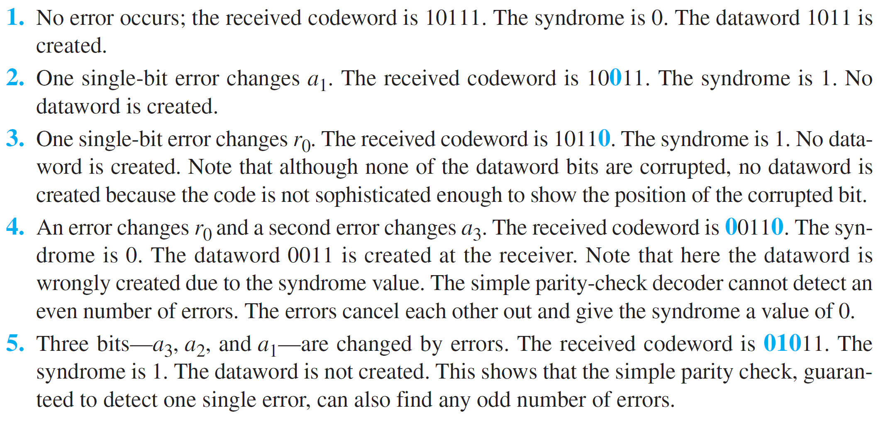
Example 10.7
Let us look at some transmission scenarios. Assume the sender sends the dataword 1011. The codeword created from this dataword is 10111, which is sent to the receiver. We examine five cases:
10.22

Slide 23
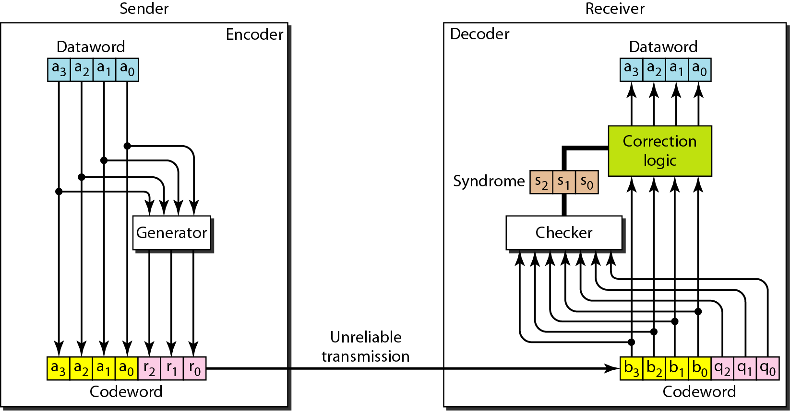
Figure 10.12 The structure of the encoder and decoder for a Hamming code

Slide 24
Hamming Code
Parity checks are created as follow (using modulo-2)
  r0 = a2 + a1 + a0
  r1 = a3 + a2 + a1
  r2 = a1 + a0 + a3

Slide 25
Hamming Code
The checker in the decoder creates a 3-bit syndrome (s2s1s0).
In which each bit is the parity check for 4 out of the 7 bits in the received codeword:
s0 = r0 + a2 + a1 + a0
s1 = r1 + a3 + a2 + a1
s2 = r2 + a1 + a0 + a3
The equations used by the checker are the same as those used by the generator with the parity-check bits added to the right-hand side of the equation.

Slide 26
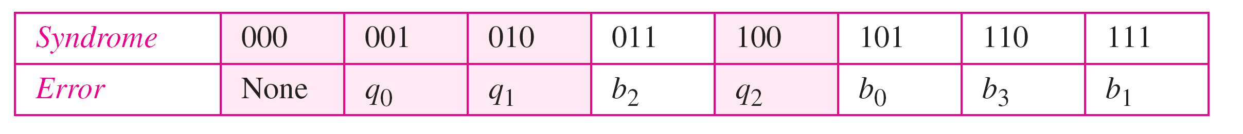
Table 10.5 Logical decision made by the correction logic analyzer
Hamming code C(7, 4) can :
detect up to 2-bit error (d_{min} -1)
can correct up to 1 bit error (d_{min}-1)/2

Slide 27
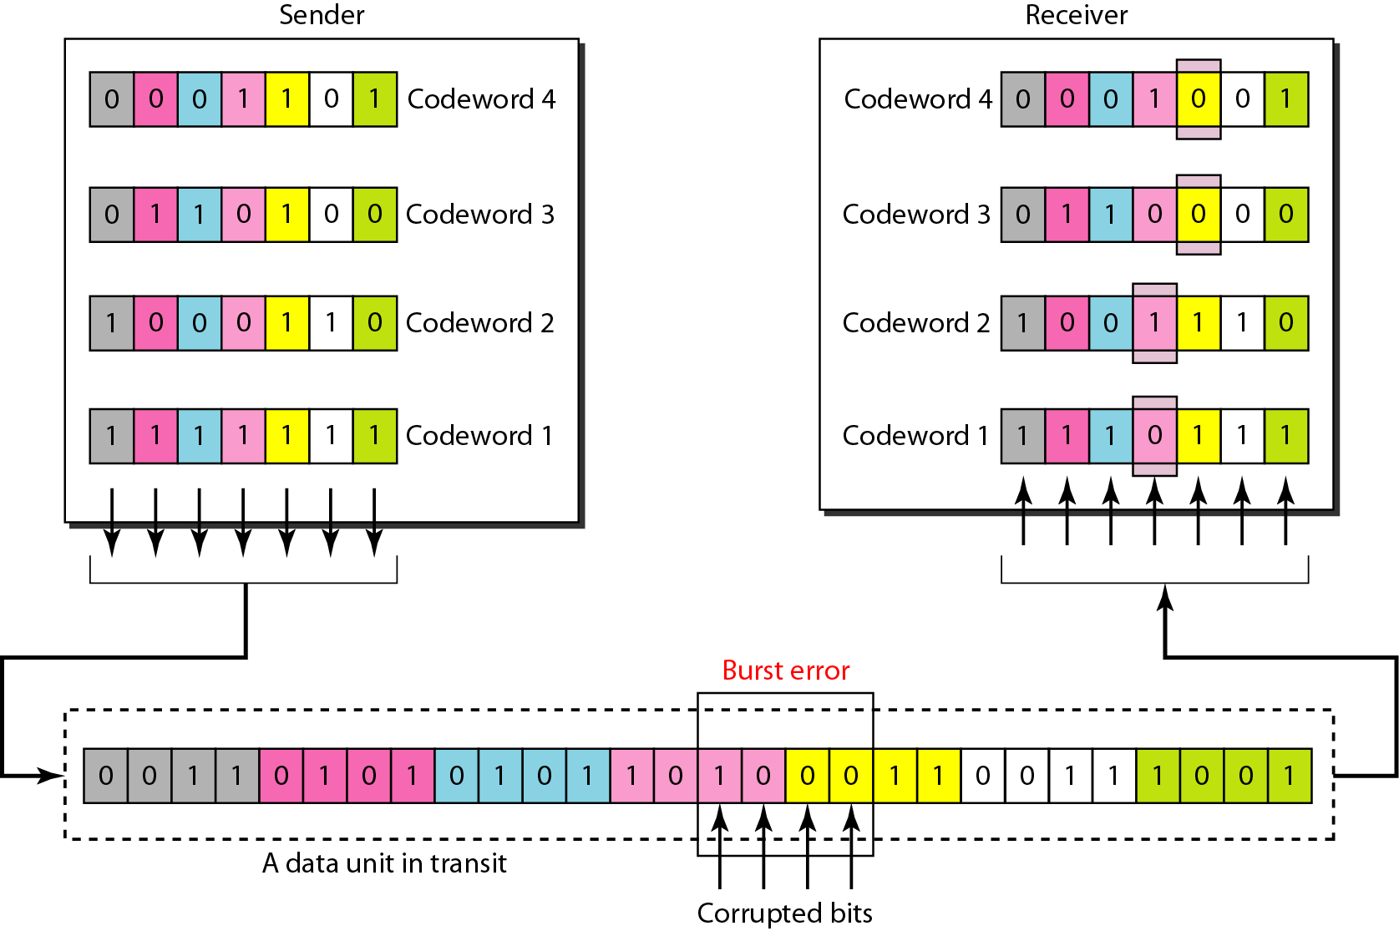
Figure 10.13 Burst error correction using Hamming code
Split burst error between multiple codewords

Slide 28
    10-3 CYCLIC CODES
Cyclic codes are special linear block codes with one extra property. In a cyclic code, if a codeword is cyclically shifted (rotated), the result is another codeword. For example, if 1011000 is a codeword and we cyclically left-shift, then 0110001 is also a codeword.

Slide 29
10.3.1 Cyclic Redundancy Check
We can create cyclic codes to correct errors. However, the theoretical background required is beyond the scope of this book. In this section, we simply discuss a subset of cyclic codes called the cyclic redundancy check (CRC), which is used in networks such as LANs and WANs.

Slide 30
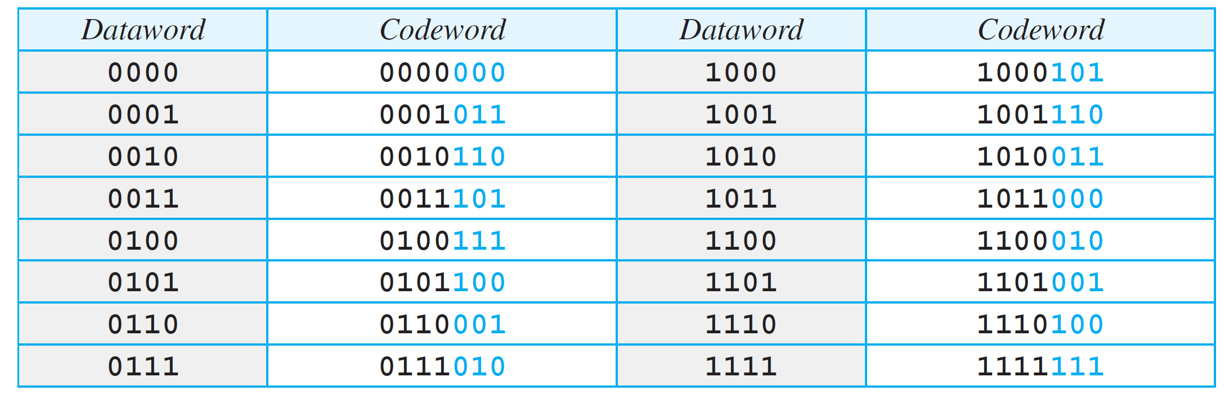
Table 10.3: A CRC code with C(7, 4)
10.30

Slide 31
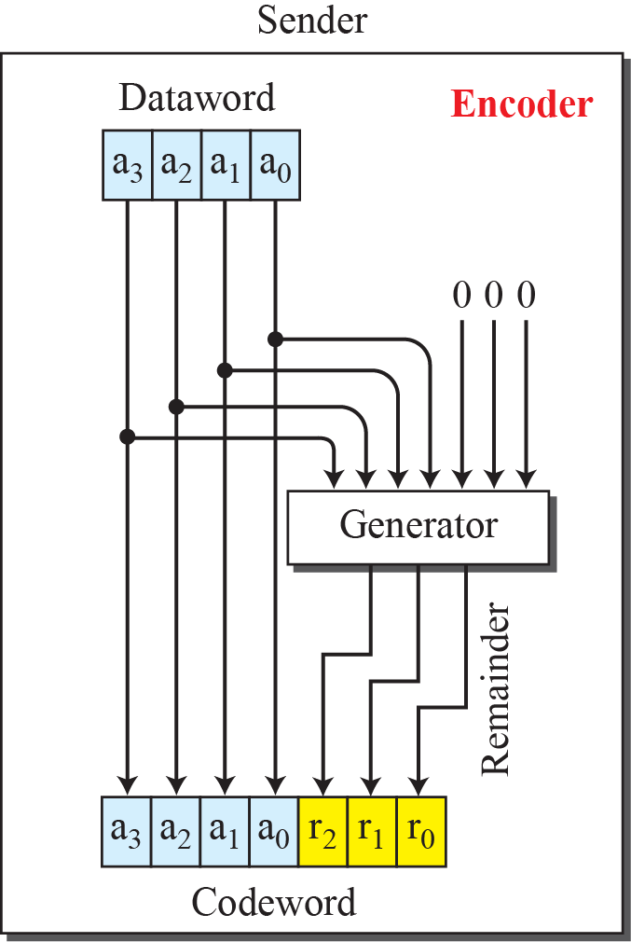
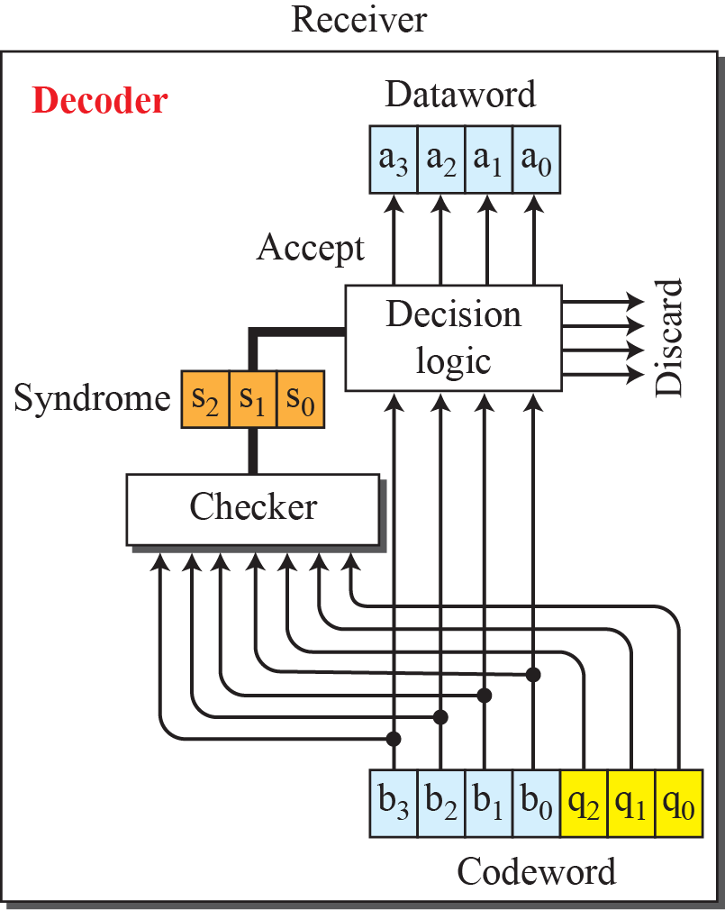
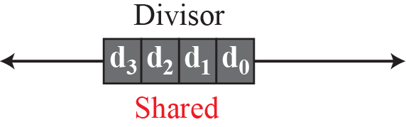
Figure 10.5: CRC encoder and decoder

Slide 32
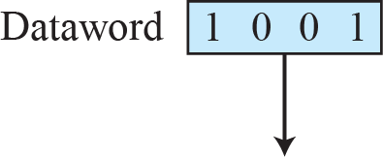
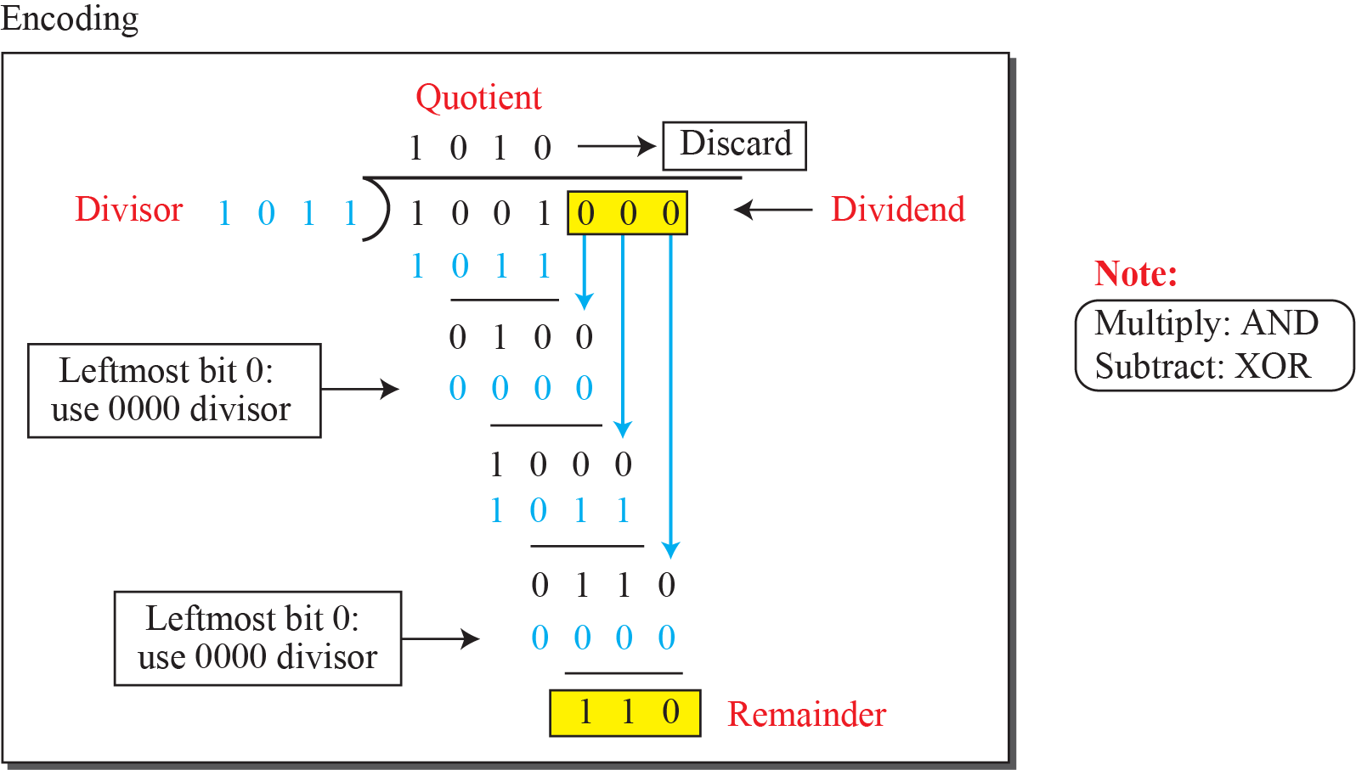
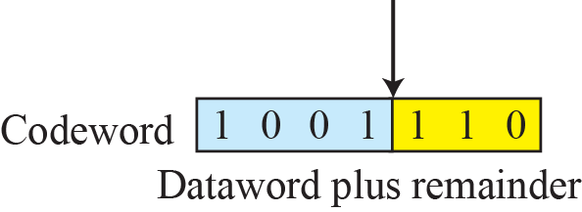
Figure 10.6: Division in CRC encoder

Slide 33
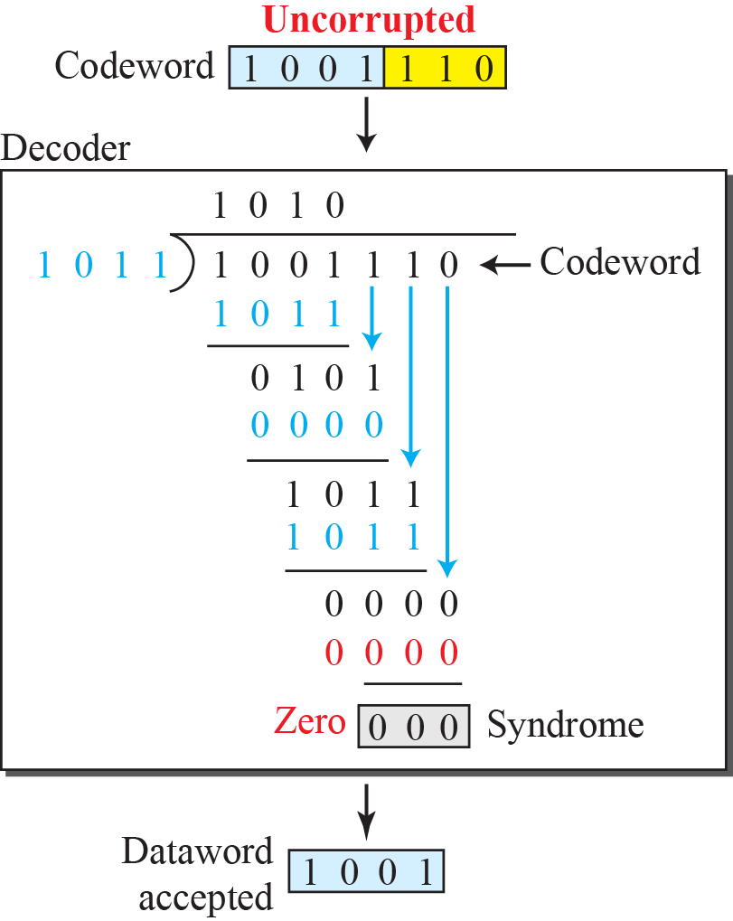
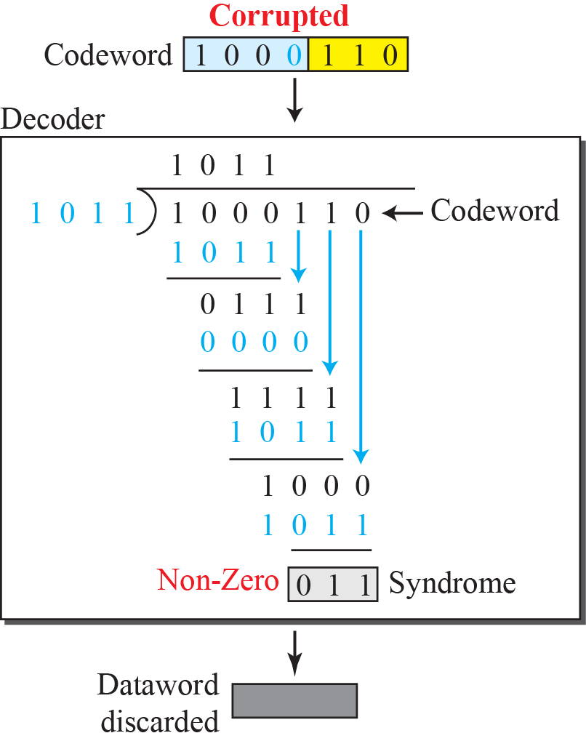
Figure 10.7: Division in the CRC decoder for two cases

Slide 34
10.3.2 Polynomials
A better way to understand cyclic codes and how they can be analyzed is to represent them as polynomials. A pattern of 0s and 1s can be represented as a polynomial with coefficients of 0 and 1. The power of each term shows the position of the bit; the coefficient shows the value of the bit. Figure 10.8 shows a binary pattern and its polynomial representation.

Slide 35
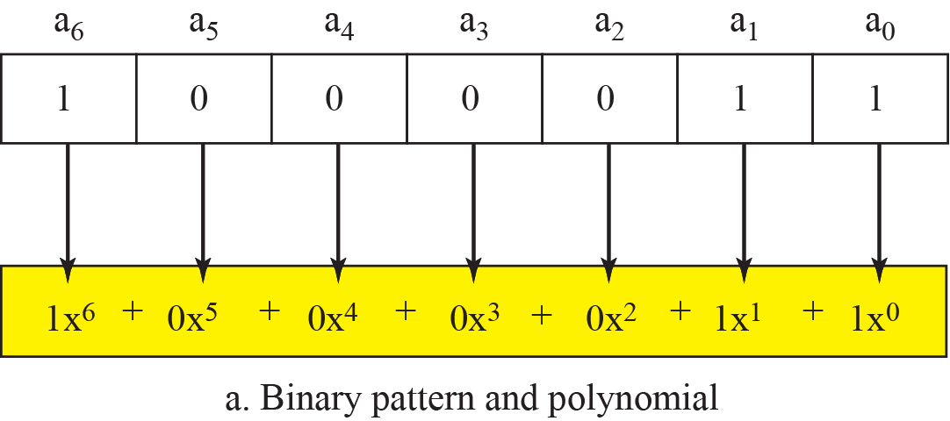
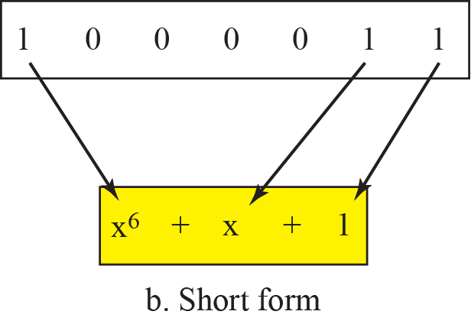
Figure 10.8: A polynomial to represent a binary word

Slide 36
10.3.3 Encoder Using Polynomials
Now that we have discussed operations on polynomials, we show the creation of a codeword from a dataword. Figure 10.9 is the polynomial version of Figure 10.6. We can see that the process is shorter.

Slide 37
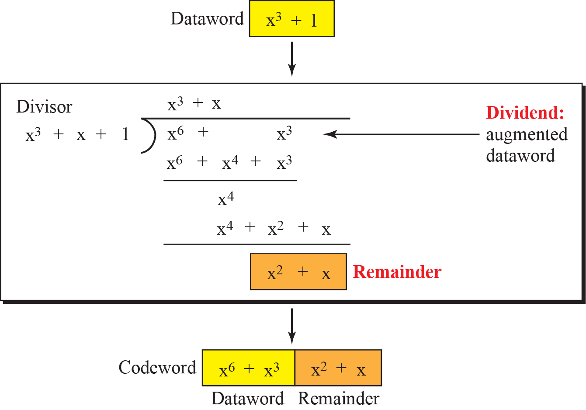
Figure 10.9: CRC division using polynomials

Slide 38


10.3.4 Cyclic Code Analysis
We can analyze a cyclic code to find its capabilities by using polynomials. We define the following, where f(x) is a polynomial with binary coefficients.

Slide 39
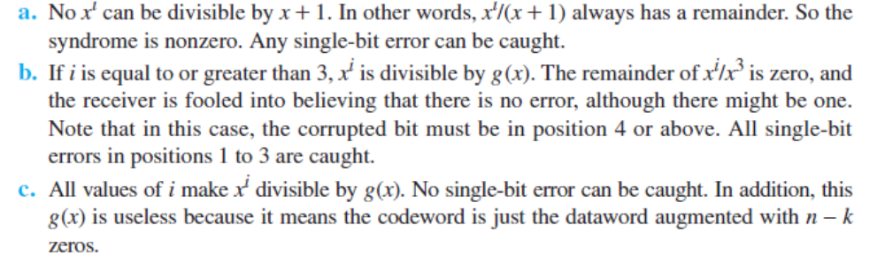
Example 10.8
Which of the following g(x) values guarantees that a single-bit error is caught? x + 1, x³ and 1
Solution
An error goes undetected iff the generator g(x) cleanly divides the error E(x) without a remainder
10.39

Slide 40
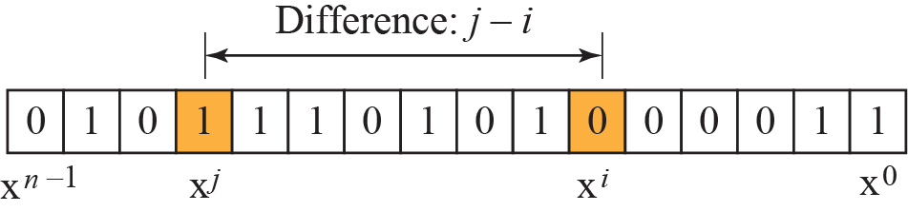
Figure 10.10: Representation of isolated single-bit errors

Slide 41
Capability of CRC in Error Detection
Single-Bit Errors
  The Error: A single bit flips during transmission. Mathematically, E(x) = x^{i}, where i is the position of the flipped bit.
  The Capability: CRC can catch 100% of single-bit errors as long as g(x) has at least two terms and an x⁰ term (a constant of 1).
Two Isolated Single-Bit Errors
  The Error: Two bits flip at different positions, i and j (where i > j).
  The Capability: To catch this, g(x) must not cleanly divide x^{j}, and it must not cleanly divide (x^^{{i-j}} + 1).
  As long as g(x) has a +1 term at the end, it will never divide x^{j}. To prevent it from dividing (x^^{{i-j}} + 1), design standard CRC generators so they will not divide x^{t} + 1 for any value of t up to the maximum frame length of the network.
10.41

Slide 42

Capability of CRC in Error Detection
Odd Number of Errors
  The Error: Any error where 3, 5, 7, etc., bits are corrupted in the frame.
  The Capability: CRC can detect 100% of odd-numbered bit errors if the generator polynomial g(x) contains (x+1) as a primary mathematical factor.
Burst Errors
  The Error: A sequence of bits where the first and last bits are corrupted, along with a random number of bits in between. If the distance between the first and last flipped bit is L, the burst error has a length of L
  The Capability: Let r be the degree of the generator polynomial g(x).
    Condition 1 (L <= r): It detects 100% of all burst errors whose length is less than or equal to the degree of the polynomial.
    Condition 2 (L = r + 1): It detects 1 - (1/2) ^{{r-1}} of burst errors whose length is exactly r + 1. For a standard CRC-32, this is a 99.99999995% detection rate.
    Condition 3 (L > r + 1): It detects 1 - (1/2)^{r} of burst errors whose length is greater than r + 1. For CRC-32, this is a 99.99999997% detection rate.
10.42

Slide 43
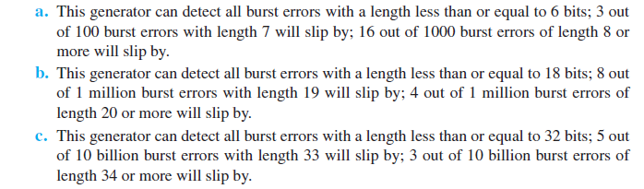
Example 10.9
Find the suitability of the following generators in relation to burst errors of different lengths: x⁶ + 1, x¹⁸ + x⁷ + x + 1, and x³² + x²³ + x⁷ + 10.
Solution
10.43

Slide 44
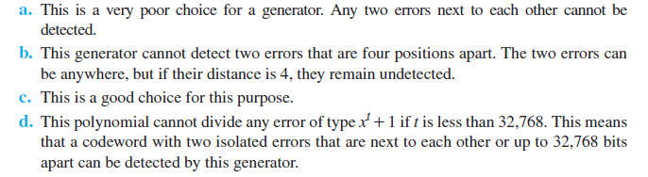
Example 10.10
Find the status of the following generators related to two isolated, single-bit errors: x + 1, x⁴ + 1, x⁷ + x⁶ + 1, and
x¹⁵ + x¹⁴ + 1
Solution
10.44

Slide 45
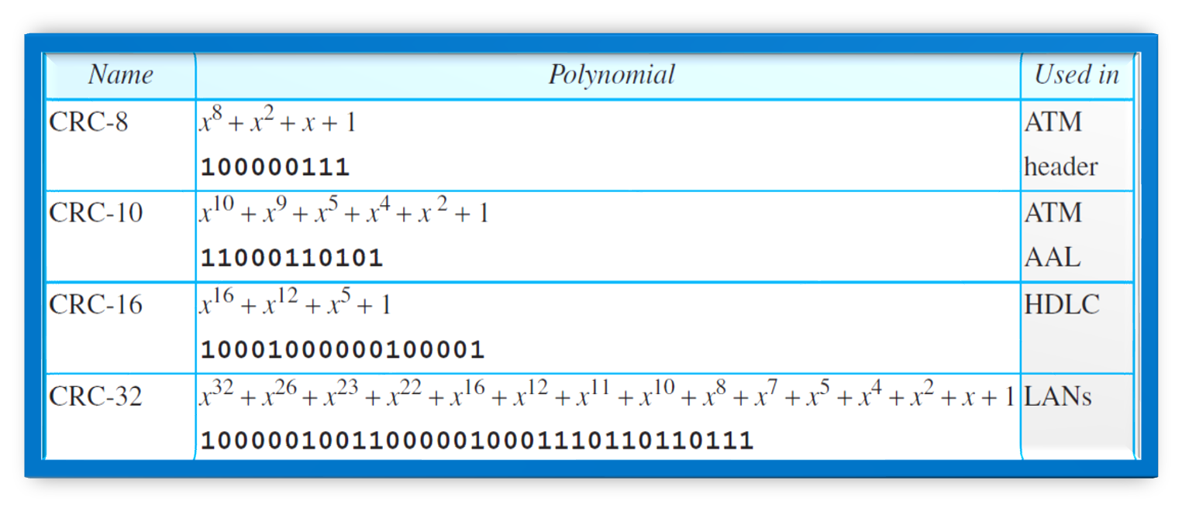
Table 10.4: Standard polynomials
10.45

Slide 46
10.3.5 Advantages of Cyclic Codes
We have seen that cyclic codes have a very good performance in detecting single-bit errors, double errors, an odd number of errors, and burst errors. They can easily be implemented in hardware and software. They are especially fast when implemented in hardware. This has made cyclic codes a good candidate for many networks.

Slide 47
10.3.6 Other Cyclic Codes
The cyclic codes we have discussed in this section are very simple. The check bits and syndromes can be calculated by simple algebra. There are, however, more powerful polynomials that are based on abstract algebra involving Galois fields. These are beyond the scope of this book. One of the most interesting of these codes is the Reed-Solomon code used today for both detection and correction.

Slide 48
    10-4 CHECKSUM
Checksum is an error-detecting technique that can be applied to a message of any length. In the Internet, the checksum technique is mostly used at the network and transport layer rather than the data-link layer. However, to make our discussion of error detecting
techniques complete, we discuss the checksum in this chapter.

Slide 49
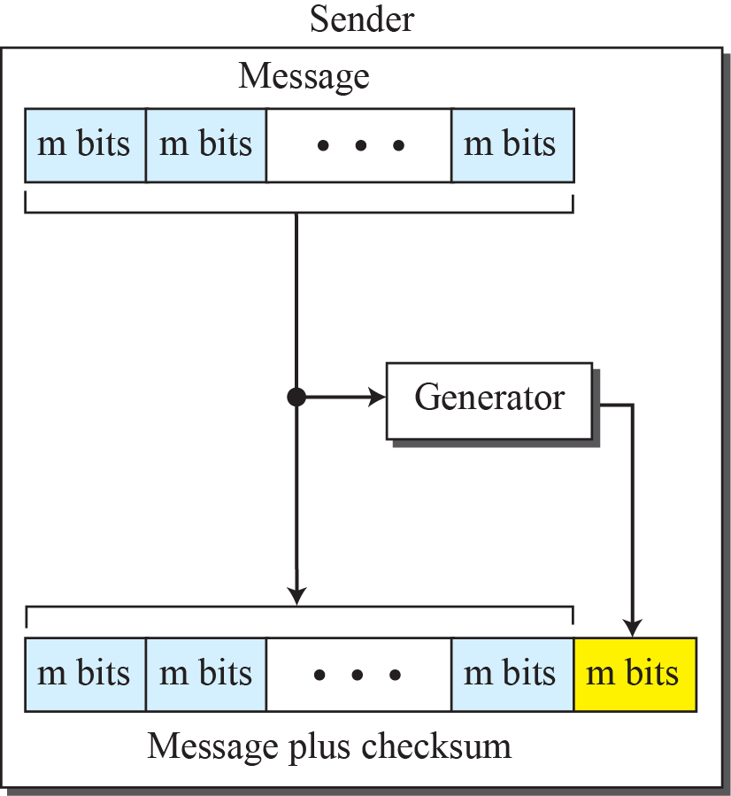
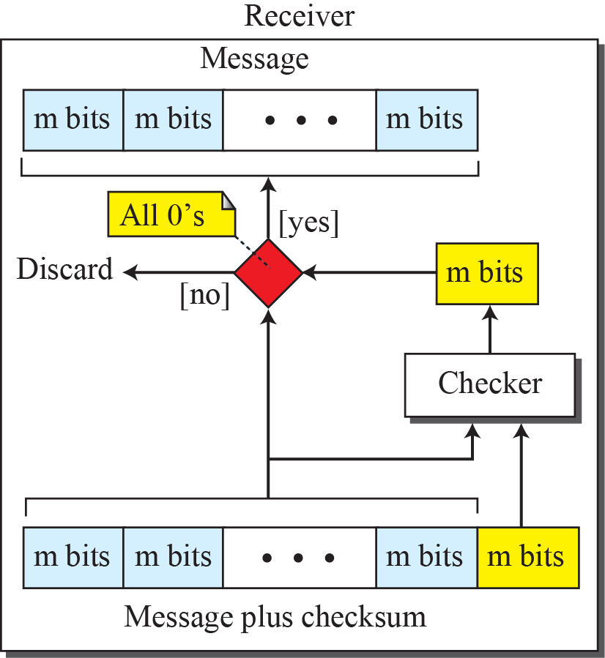
Figure 10.15: Checksum

Slide 50
Example 10.11
Suppose the message is a list of five 4-bit numbers that we want to send to a destination. In addition to sending these numbers, we send the sum of the numbers. For example, if the set of numbers is (7, 11, 12, 0, 6), we send (7, 11, 12, 0, 6, 36), where 36 is the sum of the original numbers. The receiver adds the five numbers and compares the result with the sum. If the two are the same, the receiver assumes no error, accepts the five numbers, and discards the sum. Otherwise, there is an error somewhere and the message not accepted.
10.50

Slide 51
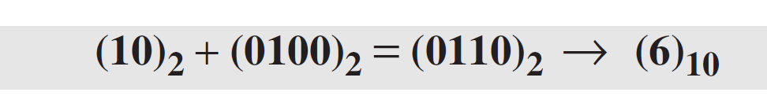
Example 10.12
In the previous example, the decimal number 36 in binary is (100100)2. To change it to a 4-bit number we add the extra leftmost bit to the right four bits as shown below.
Instead of sending 36 as the sum, we can send 6 as the sum (7, 11, 12, 0, 6, 6). The receiver can add the first five numbers in one’s complement arithmetic. If the result is 6, the numbers are accepted; otherwise, they are rejected.
10.51

Slide 52
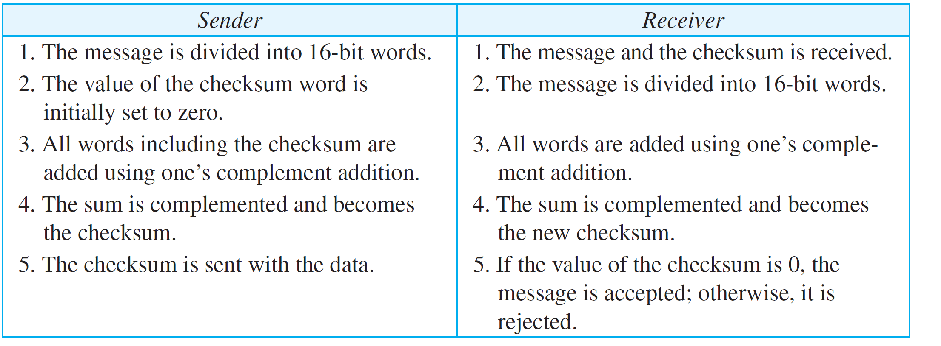
Table 10.5: Procedure to calculate the traditional checksum
10.52

Slide 53
    10-5 FORWARD ERROR CORRECTION
We discussed error detection and retransmission in the previous sections. However, retransmission of corrupted and lost packets is not useful for real-time multimedia transmission. We need to correct the error or reproduce the packet immediately.

Slide 54
10.5.1 Using Hamming Distance
We earlier discussed the Hamming distance for error detection. For error detection, we definitely need more distance. It can be shown that to detect t errors, we need to have d_{min} = 2t + 1. In other words, if we want to correct 10 bits in a packet, we need to make the minimum hamming distance 21 bits, which means a lot of redundant bits need to be sent with the data. the geometrical representation of this concept.

Slide 55
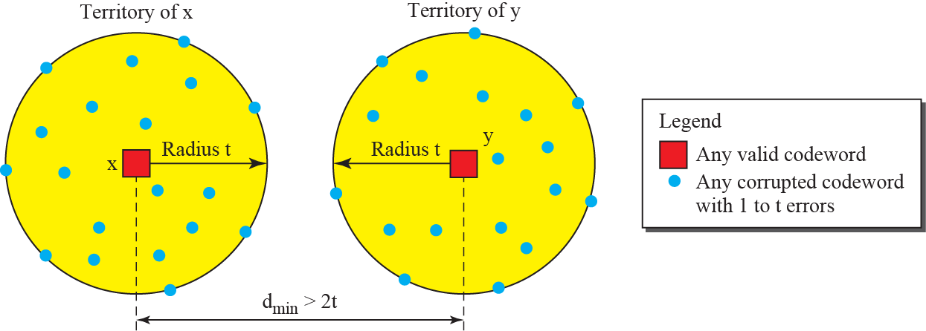
Figure 10.20: Hamming distance for error correction

Slide 56


10.5.2 Using XOR
Another recommendation is to use the property of the exclusive OR operation as shown below.
This means:

Slide 57
10.5.3 Chunk Interleaving
Another way to achieve FEC in multimedia is to allow some small chunks to be missing at the receiver. We cannot afford to let all the chunks belonging to the same packet be missing; however, we can afford to let one chunk be missing in each packet.

Slide 58
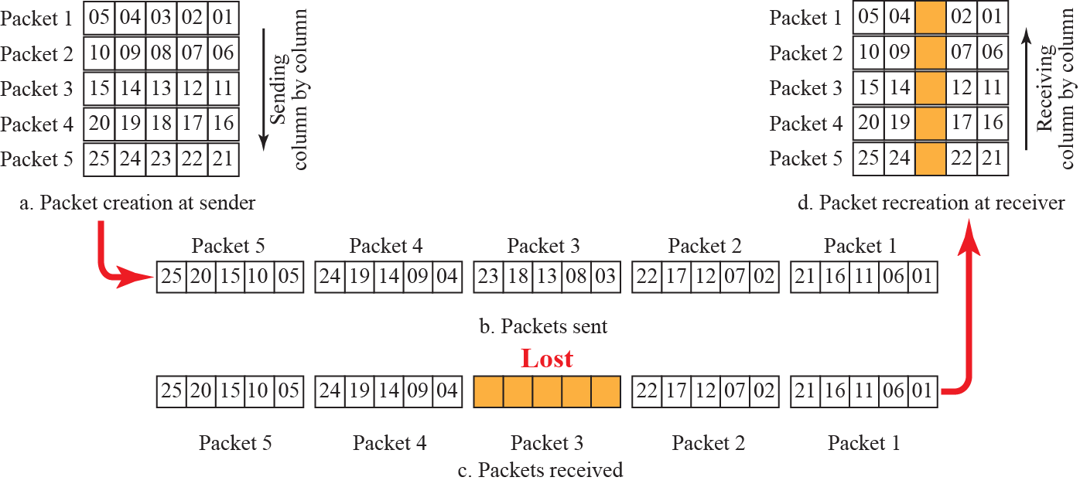
Figure 10.21: Interleaving

Slide 59
10.5.4 Combining
Hamming distance and interleaving can be combined. We can first create n-bit packets that can correct t-bit errors. Then we interleave m rows and send the bits column by column. In this way, we can automatically correct burst errors up to m × t bits of errors.

Slide 60
10.5.5 Compounding
Still another solution is to create a duplicate of each packet with a low-resolution redundancy and combine the redundant version with the next packet. For example, we can create four low-resolution packets out of five high-resolution packets and send
them as shown in Figure 10.22.

Slide 61
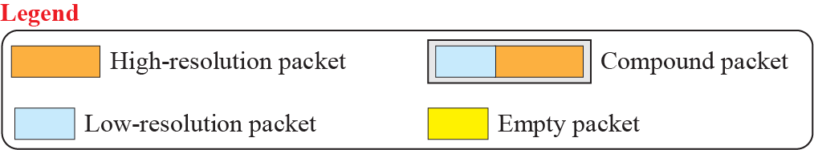
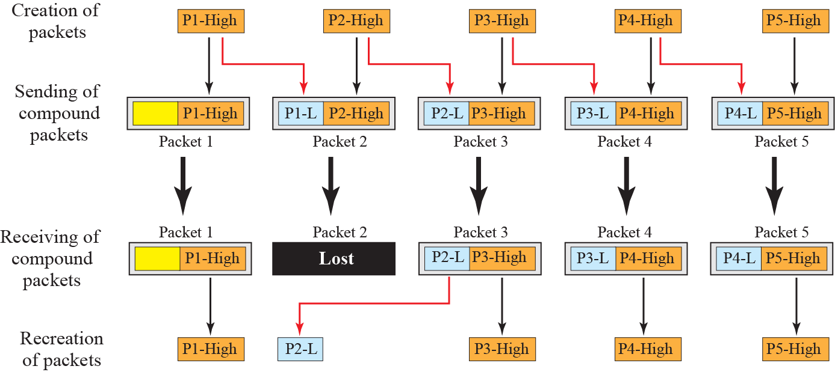
Figure 10.22: Compounding high-and-low resolution packets

